Slide 1


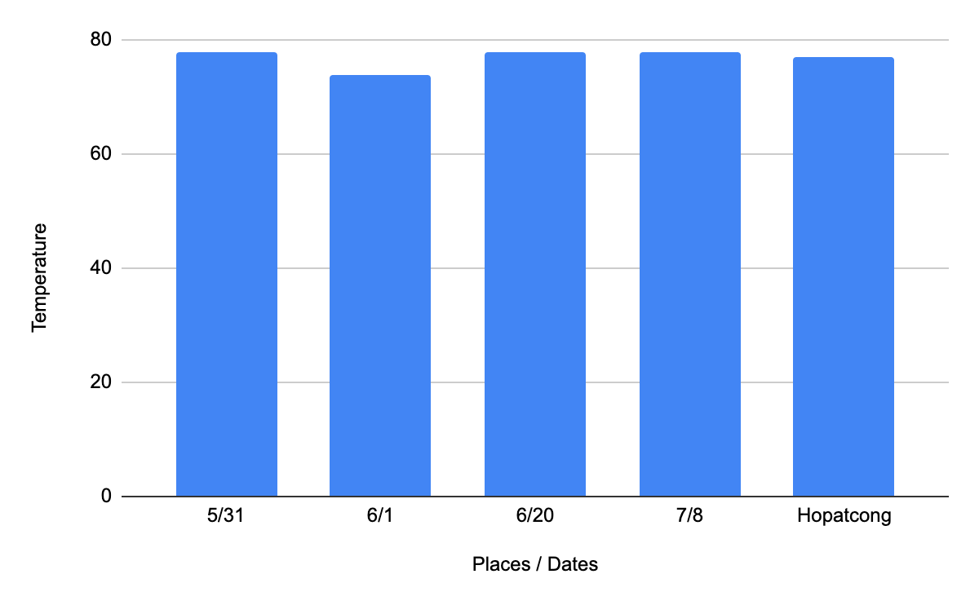
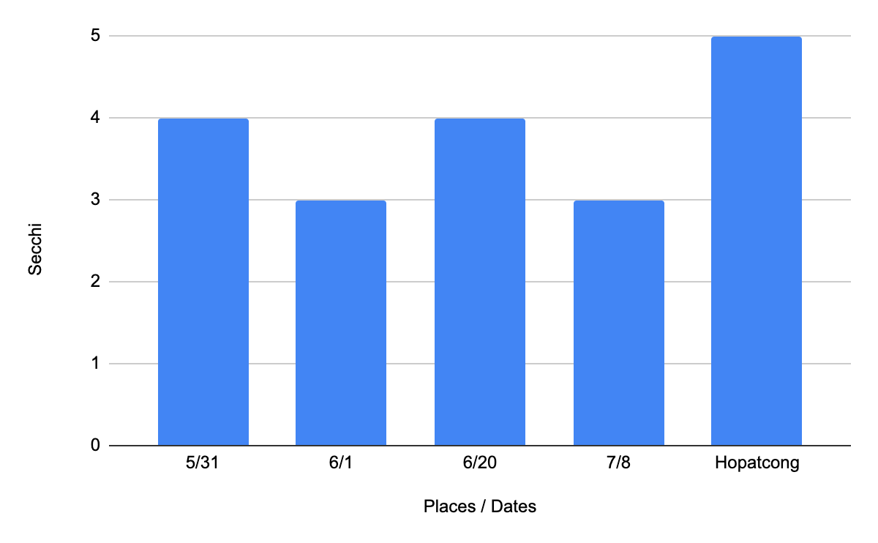
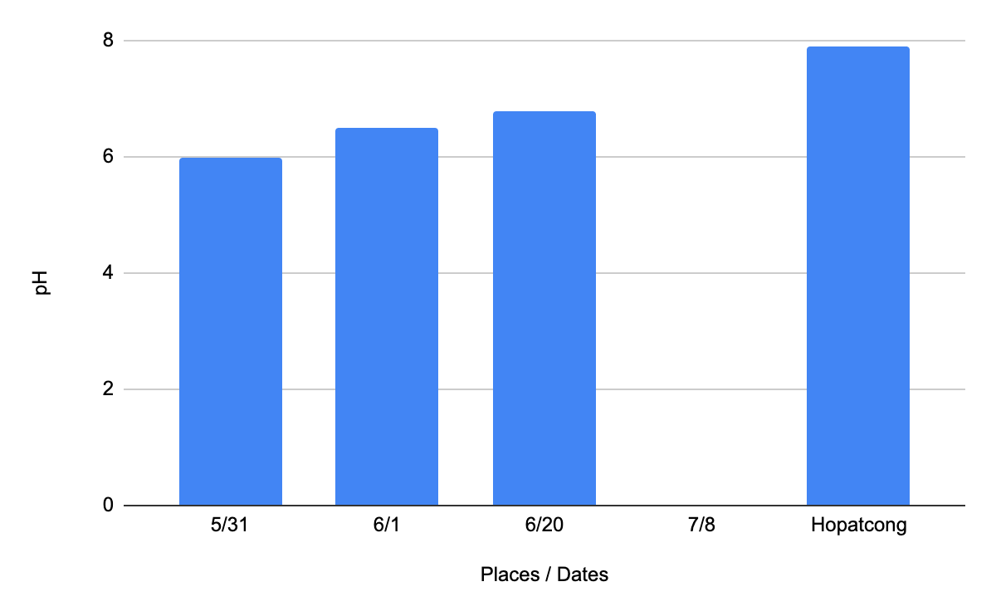
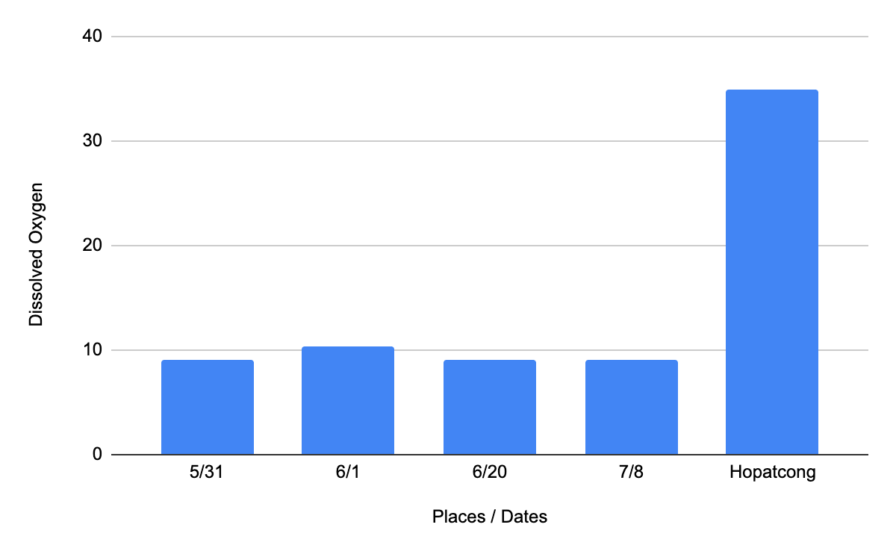
Examining Water Quality in Ponds and Lakes
Ayan Joshi, Future Leader Academy, Fredon, NJ
Nandini Menon, Advisor/Mentor - New Jersey Institute of Nature
Dr. Steve Komar, Rutgers University Extension Consultant, New Brunswick, NJ
Reviewed by Dr.Mansoor Amiji, Professor, Northeastern University, Boston, MA
Reviewed by Dr.Barbara Schmidt, Metuchen, NJ
New Jersey Institute of Nature
Background
Experimental Method
Findings
Conclusion
Farm lands and agricultural practices have a vital role in mitigating the harmful effects of Climate Change. The presence of organic content in soil effects soil structure, water quality and the nutrients in both media. Pasture management includes maintaining the soil nutrients to enable healthy plant growth, Pastures with an average pH of 6.6 is ideal for nutrient utilization to promote pasture growth and production (Mickel, 1994).
Materials Used:
Hula hoop
Showel
Plastic bag to collect soil sample.
Soil samples(2 per paddock)
Phase 1 -
1.Throw a hula-hoop in each paddock. Take a picture of the plants within the hula hoop. Next take a soil sample. Repeat in another area of the paddock.
Prepare the soil sample for testing:
Place soil samples into a clean container, sift the soil and remove organic matter and stones(small and large). To test pH, add soil to fill line and add distilled water to the to the water line. For Nitrogen, Potash and Phosphorus tests, add 250 ml to 50 ml of the soil, stir the mixture and let it stand for a minimum of 30 minutes.
Testing:
Select appropriate comparator for the test. Remove the cap, using the dropper provided fill the test and reference chambers to the fill mark with the solution from the soil sample. Remove appropriate colored capsules. Hold the capsule horizontally over the test chamber and pour the powder into the test chamber. Cap the comparator. Allow color to develop for 10 minutes. Compare the color of the solution in the test chamber to the color chart.
Water Test:
Fill the given test tube with the water sample( soil mixture or pond water) using the given pipette.
Insert the 16 in 1 water testing strip into the test tube for 2 seconds and take it out.
Remove excess water and lay the strip horizontally for 30 seconds.
Using the color chart provided match the shade of the test strip to the appropriate color chart.
Alkalinity:
Alkalinity is the total concentration (as mg/l of CaCO3) of bases in the water, primarily bicarbonates, carbonates, and hydroxides. Adequate alkalinity is important for pond productivity and water chemistry. CaC03 is the chemical composition for calcium carbonate and when measuring alkalinity one can just say mg/L.
Secchi Test:
A secchi disk is a disk with a black and white pattern made to determine the water turbidity. To do the secchi test, you drop the disk into the water and you keep lowering it until you can’t see it. Finally, bring the disk up and count the marks on the rope. Each mark is ½ meter. Once the disk is all the way up, you should have an answer in meters
Based on my research, Lake Hopatcong depth affects its health. Lake Hopatcong is around 33 feet in depth. Dissolved Oxygen, or the oxygen that aquatic life (with gills) breathe in, is affected because of this. The dissolved oxygen in Lake Hopatcong is 35. This is because of the depth of the pond. According to oceanexplorer.noaa.gov,”At deeper depths, oxygen gradually increases as lower temperatures increase the solubility of oxygen.“ Then, the dissolved oxygen increases alkalinity. For example, in Hopatcong the dissolved oxygen was 35 but the pH was 7.9. At Fredon, our dissolved oxygen was 9-10 but the pH was around 6.5. This correlation also affects lake health.
My results show that the pH in Lake Hopatcong (7.9 - slight alkalinity) has more alkalinity than the pH at the Fredon pond. This is because 7.9 is very close to neutral and therefore considered cleaner in terms of pH value. The turbidity of a lake is determined by doing the Secchi disk test. The Secchi disk test at Lake Hopatcong was 5 feet and at Fredon Pond was 3-4 feet. However,the Secchi Disc tests conducted at Lake Hopatcong and Fredon cannot be compared because the Fredon pond is more shallow than Lake Hopatcong. The depth of Fredon pond is 4 ft in the small pond and 9 ft in the larger pond, whereas Lake Hopatcong is 33 ft deep. The shallowness of the Fredon Pond is reflected in the turbidity test results. The temperature in Hopatcong and the Fredon Pond ranges from 74 - 78°F. This is considered normal for the region and due to the current heat wave. The dissolved oxygen measured at Lake Hopatcong was 35 ppm and at Fredon pond was 9.5 ppm. This again cannot be compared because dissolved oxygen is directly proportional to the depth of the water body, deeper the waterbody, the more dissolved oxygen there is.
Purpose of the Study
Results
The purpose of this experiment is to build a better understanding of turbidity, alkalinity, pH and dissolved oxygen in water bodies.
Temperatures in Fredon Pond and Hopatcong
Methods
Soil samples from three paddocks were chosen.
Paddock 5 - the land near to the pond, very less bald spots
Paddock 6 - 2nd closest to the pond, mild bald spots
Paddock 8 - 3rd farthest away from pond, many bald spots
Two samples from each paddock were taken, and mixed together. Next the soil was filtered to remove organic matter, stones such that a fine soil mix remained. 50 ml of the soil was mixed with 250 ml of distilled water. The solution was stirred for 5 minutes. The soil solution was stored for 1 hour .
Water samples were taken from the Fredon pond.
(a) Water sample taken fro the edge of the pond.
(b) Water samples were taken from the center of the small and big pond.
(c ) Water samples were taken from Swartswood Lake.
(d) Water samples were taken at Lake Hopatcong and tested.
Discussions
These findings not only affect the water but also affects aquatic life and humans. Aquatic organisms and fish cannot survive in a pond that has too little dissolved oxygen. Fish take in dissolved oxygen in the water and not oxygen from the air.
The water quality is dependent on the amount of dissolved oxygen. Less dissolved oxygen affects the water quality which can in turn harm us. Less dissolved oxygen can cause the waterbody to die, because when there is less aquatic life, the water does not have the necessary nutrients.
Another important factor for water quality is water turbidity. Turbidity is the existence of organic matter in the waterbody. The clarity of the lake is reduced by the presence of suspended sediments, bits of organic matter, free-floating algae and zooplankton.
Future Research: My next investigation will be to analyze the effect of temperature on turbidity and dissolved oxygen. My hypothesis is that if the temperature changes too quickly and drastically, aquatic life will get exterminated.
Secchi in Fredon and Hopatcong
Measures
Rapitest Soil test
The test uses a patented 4 chamber device called color comparators - one each for pH, Nitrogen, Phosphorus and Potash. The test involves comparing the color of the water tested to a color chart.
pH scale - 7.5 Alkaline; 7.0 - neutral; 6.5 - slight acidic; 6.0 - acidic; 5.5 - acidic; 5.0 - very acidic; pH - very acid.
N Test - N4- surplus; N3 - sufficient; N2- adequate; N1 - Deficient; No - Depleted.
P Test - P4 - surplus; P3 - sufficient; P2 - adequate; P1 - deficient; P0 - depleted
K Test - K4 - surplus; K3 - sufficient; K2 - adequate; K1 - deficient; K0 -depleted
Water Quality test: Water test strips that tested 16 items - Total alkalinity, pH, hardiness, Cyanuric acid, total chlorine, free chlorine, Bromine, Nitrate, Nitrite, Iron, Chromium, Lead, Copper, Mercury, Fluoride, and Carbonate root.
Testing conditions: Ambient temperature
Plant Etymology
Plants in the paddock are identified using Picture this(app).
I
Dissolved Oxygen in Fredon and Hopatgong
pH in Fredon and Hopatgong
References
US Department of Commerce, N. O. and A. A. (2018, May 10). Education: Lesson Plans: NOAA Ocean Exploration. Retrieved July 22, 2022, from https://www.oceanexplorer.noaa.gov/edu/lessonplans/lessonplans.html
Understanding water quality parameters to better manage Your pond: New mexico state university - be bold. shape the future. Understanding Water Quality Parameters to Better Manage Your Pond | New Mexico State University - BE BOLD. Shape the Future. (n.d.). Retrieved July 22, 2022, from https://pubs.nmsu.edu/_w/W104/index.html
Notes:
1

